Slide 1

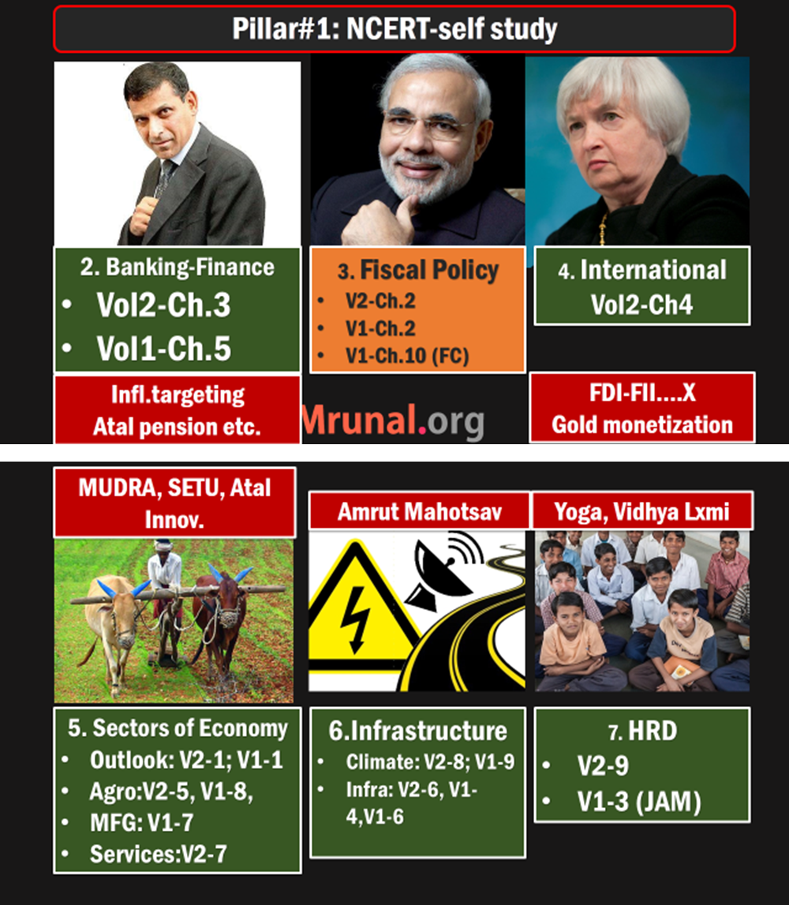
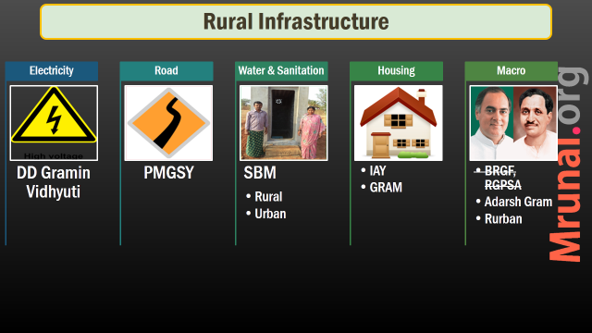
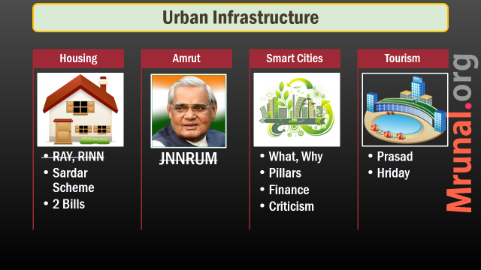
Today: communication & Climate Change

Slide 2
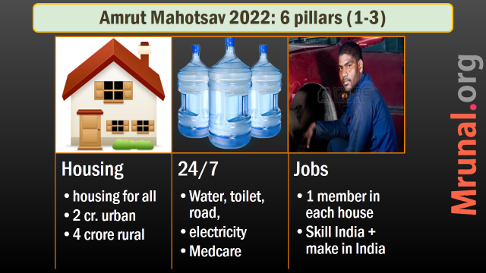
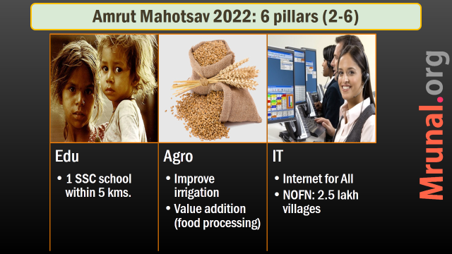
E-services for
Rurban, Amrut, Smart cities, Prasad, HRIDAY
IT jobs
E-Learning
Digital India Mission
GS2: e-governance:- applications, models, successes, limitations, and potential;
GS3: social networking sites in internal security challages
GS3: basics of cyber security

Slide 3
Digital India Mission (by 2019)
Department of Electronics and Information Technology
Broadband Highway
Universal Mobile
E-Governance
E-Kranti
Info. to all
IT jobs
Early Harvest
ZERO import
Public Internet

Slide 4
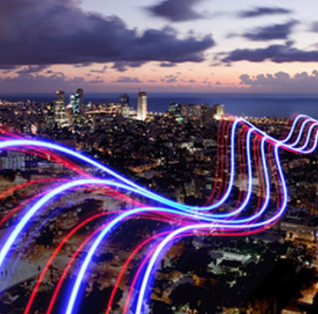
#1: Broadband Highway
Digital India
Rural India: National Optical Fibre Network Project under DOT.
Connect 2.5 lakh gram panchayat by 2016-end.
Kerala’s Idduki district 1st to connect
States option to finish themselves, DOT to pay. (Andhra accepted)

Slide 5
Broadband Highway
Digital India
Urban area: compulsory IT infra in new buildings
National information infra- to integrate following
SWAN (State wide area network)
NOFN (Nat. Optical fibre network)
NKN: National Knowledge Network

Slide 6

#2: Public internet Access
Digital India
#2: Public internet Access
CSC: common service centre
1.5 lakh Post offices
Cities with 1 mil. Pop: public wifi hotspots (Smart, Amrut, Prasad, Hriday…L7P4.pptx)
Railway station wifi (L7P1.pptx)
#3: universal mobile connectivity
In NTP, USOF, Spectrum auction

Slide 7

#4: E-governance BPRe
Digital India
Business Process re-engineering
Forms simplified, All database electronic.
Automated workflow in office
Public grievances redressal- “online ticket system”, big-data analysis to make reforms
Digital locker to save School-certificate, Voter ID card

Slide 8

Digital India #5: E-Kranti module
E-Edu
E-Healthcare
E-Farming
Free wifi in school
Massive Online Open Courses (MOOCs)
Digital Literacy
Online medical records
2015 x 3 years full coverage
telemedicine
Market Price info., extension service
Buy inputs online
Online loan, banking, payment
E-Justice
Court, police, jail
Prosecution database
Financial inclusion
Mobile banking
Jan-Dhan – net banking
Security & planning
CERT-In
GIS: decision making
National E Governance program (NeGP to be revamped)

Slide 9

India Yearbook
Ch. 8 Communication and IT
Page 192-193: NEGP and its modules

Slide 10
Digital India Mission (by 2019)
Department of Electronics and Information Technology
Broadband Highway
Universal Mobile
E-Governance
E-Kranti
Info. to all
IT jobs
Early Harvest
ZERO import
Public Internet

Slide 11
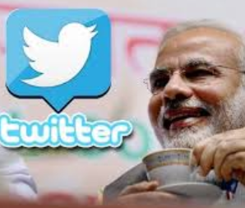
#6: info. to ALL
Digital India
Digital locker to host information, documents
2 way communication with Government
Social media, twitter, facebook
Mygov.in
Govt. to send message to people on special program/ festivals

Slide 12

#7: ZERO import by 2020
Digital India
Convergence with Make in India, skill India, ATAL, SETU (L5P3 & P4)
Convergence with Foreign Trade Policy 2015 (L6P1 & P2)
Tax incentives, incubation centres
Government procurement (WTO non tariff barrier?)
Set top box, mobile, medical electronics, smart energy meters, smart card, micro-ATM

Slide 13
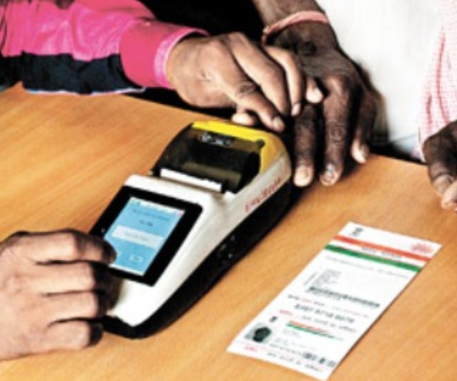
Micro ATM
GS3 S&T
HCL, Verifon etc. ~10k each device
PoS Point of sale device for cash distribution
Money in aluminum safe box- manually taken out by agent
GPRS connected, Finger print authentication
Aadhar Seeded Jan Dhan Account=> Banking business correspondence agent (BCA)=> DBT
Notes:
As such old topic from 2013 but re-appearing often in schemes

Slide 14
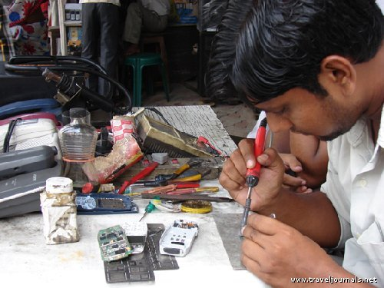
#8: IT job
Digital India
0% IT import- scope for mid-skilled workers
(DE-ITY) Train 1 crore IT ready workforce in RURBAN areas L7P3.pptx
(DoT) Telecom companies to train youth for their own rural-penetration
NE: BPO promote
IT-teachers in schools, polytech, skill centres
Staff at Common service centre (CSC)
Notes:
As such old topic from 2013 but re-appearing often in schemes

Slide 15

#9: Early Harvest programs
Digital India
Mass messaging application for elected & appointed officials
Secure email service for all employees
Standardized Government email/ file design/templates to ▼ time.
E-greeting through mygov.in
Biometric attendance in all offices.
Notes:
Biometric device- through domestically mfg.

Slide 16
#9: Early Harvest programs
Digital India
Wifi in all universities via NKN
School books=> Ebooks, interactive learning
SMS based weather-disaster info.
Lost and found children- national portal => khoyapaya.gov.in
By Minister for Women and Child Development
Notes:
Biometric device- through domestically mfg.

Slide 17
Digital India Mission (by 2019)
Department of Electronics and Information Technology
Broadband Highway
Universal Mobile
E-Governance
E-Kranti
Info. to all
IT jobs
Early Harvest
ZERO import
Public Internet

Slide 18

2019 Rs.1.13 lakh crores
End result?
Broadband in 2.5 lakh villages
100% phone coverage
4 lakh public internet access points
2.5 lakh schools with wifi
All universities to have wifi
0% import of IT / electronics
Jobs: direct 1.7 cr, indirect 8.5 crores.
Notes:
1 lakh crore: existing schemes
13k in new schemes

Slide 19
Q: “X” Premise. discuss relevance of “Y”
Discuss the importance of Digital India mission to bridge divide between India vs Bharat / Rural vs Urban India
To reap India’s demographic dividend, its existing society & economy must be transformed into digital empowered society and knowledge economy respectively. Discuss the significance of Digital India mission in this context.

Slide 20
Knowledge +IT divide =poverty, imbalance.
Ans.
NOFN, NKN, USOF, public wifi: Digital divide ▼ within area, rural vs urban area
E-Kranti: urban amnesties in rural areas
E-Literacy + target 0% Import =IT jobs in rurban areas ▲
9 pillars- few points on each
End result: digitally empowered society + knowledge economy = $$, amnesties

Slide 21

Solutions?
broadband
NIC / DEITY not equipped to deliver public internet & e-governance at such large scale.
Broadband- 125th, below Sri Lanka & Bhutan
Make Wireless Planning Commission (WPC) A statutory body
5% levy on mobile licenses
0% license fees for broadband Cos.
Some ‘package’ desktop + broadband. (similar to Airtel-Iphone plan)
Involve private sector

Slide 22

White-FI
Private IT
200-600 Mhz: Television signals.
But 93% not utilized.
Microsoft wants this unused “white space” for internet delivery
1 router: Rs.10 lakh
Wifi Range: 10km, speed 16mbps
Already done US, UK, Singapore & Kenya

Slide 23

Solutions?
broadband
White-fi technology click me
Google helium balloons (Project Loon) Link
Facebook drones, internet.org Link
End result: net neutrality vs. internet.org (EXCEL file=>science)

Slide 24
E-Governance
Page 188: National policy on electronics (NPE)
Page 192: National e-Governance plan (NeGP) and its projects
Meghraj (cloud computing)
194: dial.gov, e-taal utility
195: NKN utility
199: FOSS Free & Open source software (BOSS, EduBOSS OS)
200: NIC, 210: NIELIT,211: ERNET
Notes:
Otherwise your answer is incompplte for financial inclusion

Slide 25
Cyber security
Page 201: Controller of Certifying authority (CCA)
Page 201-205: Cyber Appellate tribunal, CERT-IN, Cyber forensics “secureyourpc.in”
Notes:
Otherwise your answer is incompplte for financial inclusion

Slide 26
IT Organizations
206: SAMEER (microwave)
207-09: CDAC, Paramyuva-II, Chakra dynamic firewall, E-nose, Meghdoot clout platform: dig google as and when necessary
201: NIELIT
211: CMET

Slide 27
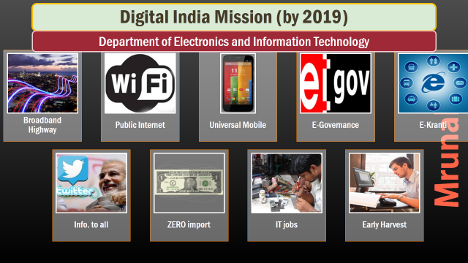
NEXT: Spectrum Auction

Slide 28
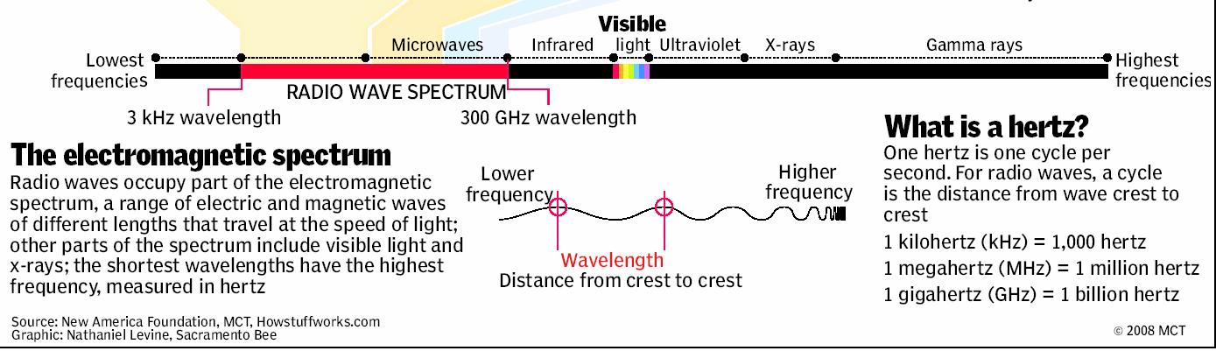

Slide 29
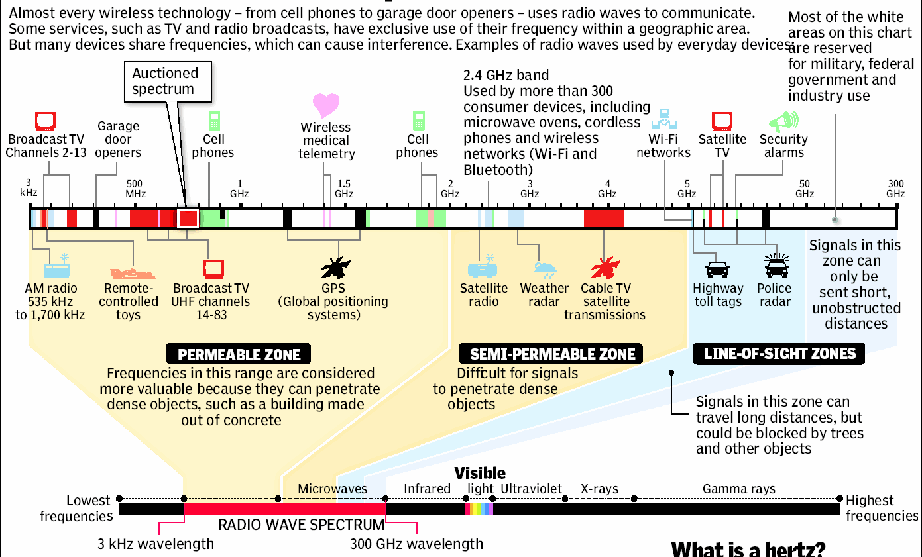

Slide 30
Electromagnetic radiation types
frequency | type of electromagnetic radiation | typical use | wavelength
highest | gamma radiation | killing cancer cells | shortest
 | X-rays | medical images of bones
 | ultraviolet | detecting forged bank notes by fluorescence
 | visible light | seeing
 | infrared | optical fiber communication
 | microwaves | cooking
lowest | radio waves | television signals | longest

Slide 31
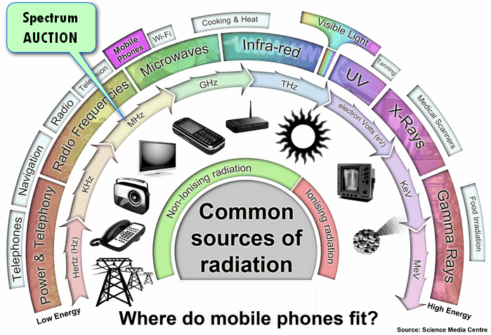

Slide 32
Mining & Communication
MMDR
Coal
Spectrum
Features
Pros
Anti
Scam
Pros
Anti
NTP-2012
Auction
Pros | Anti

Slide 33
Why spectrum allocation / auction?
Radio waves: communication
License else national security compromised.
2 operators using same frequency (Hz) in same region = interference.
Govt. divided India into 22 telecom circles.
Govt. allots spectrum rights in 22 circles.

Slide 34
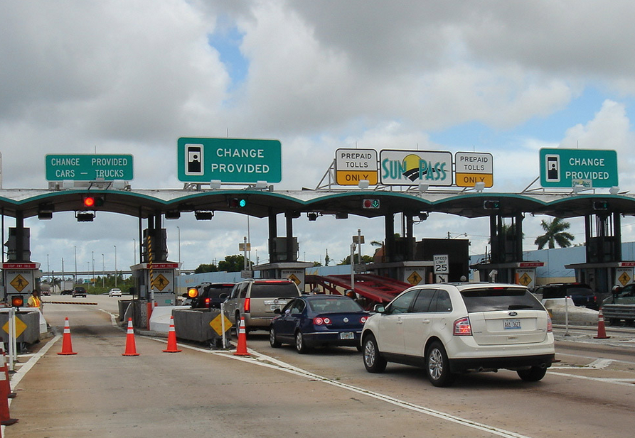

How to run a transport service?
LICENCE to drive truck
Toll for using highway

Slide 35

What happened in 2g scam?
Company
License
Spectrum Free with license
1st come 1st serve
Sold to 3rd parties at
higher price

Slide 36
No xp of running telecom network!
Swan (Shahid Balwa)
Bought 1500 cr
Sold to Eitsalat @6000 cr.
Unitech (Sanjay Chandra)
Rs.1600 cr.
Rs. 6200 cr. To Telenor (Norway)

Slide 37
2g scam: Fallout?
Windfall gain to companies with no-XP
Revenue loss to Govt. ~1.76 lakh crore
2012: SC cancels 122 license: companies stuck, bank NPA ▲
Foreign investors confidence ▼

Slide 38
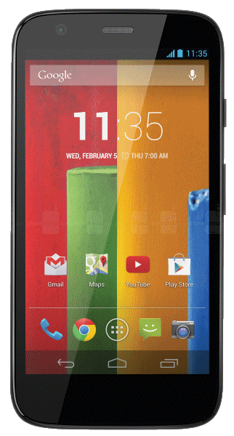
Telecom 2012
Policies
2020: rural teledensity increase to 100 =>Universal service obligation fund USOF for rural/naxal areas
Right to broadband with 2mbps speed=> NOFN National optical fiber network to connect 2.5 lakh Gram Panchayat + Digital India
Make Mobile a socio-economic empowerment=>Aadhar SIM LINK
All India mobile no. portability (right now only circle wise. Total 22 circles)

Slide 39
Telecom 2012
Policies
Simplify M&A in telecom industry
Make India a global hub for telecom mfg., VoIP, Cloud computing
Allot Spectrum in transparent, market determined price.

Slide 40
Telecom Policy 2012: spectrum delinked from license
Company
License
Buy separately for 22 circles
Unified for 22 circle
Auction

Slide 41
Higher Freq (hz)= more data /per second
~100Mhz: FM Radio
800 Mhz: CDMA
900 Mhz: Voice calls
1800 Mhz: 4G (US, S.Korea)
2100 Mhz: 3G Internet in India
2300 Mhz: 4G internet (Mukesh’s Reliance Jio own it)
These auctioned in 2015 March
Previous auction in 2014
First time auctioned in India

Slide 42

Spectrum auction method
2015
"First-come-First-serve“
Competitive e-Bid. Highest bidder wins
License tenure: 20 years.
If 2100 Mhz: pay 1/3rd amt. in 10 days
Remaining 2/3rd amt. in 10 installments x 12 years
Highest revenue: Maharashtra > Andhra Pradesh > Rajasthan
Notes:
Auction for 17 out of 22 circles

Slide 43

Participants 7 / 8 won
2015 Auction
Idea cellular | 30100 cr.
Airtel | 29130 cr.
Vodafone | 25810 cr.
Tata teleservice | 10101 cr.
Reliance jio infocom | 10078 cr.
Reliance communication | 4299 cr.
Aircel | 1350 cr.
Uninor | -- no spectrum--
Notes:
Not much important for UPSC

Slide 44
Spectrum auction 2015: Implications
Government
Consumer
Companies
Higher than expected (1.1L cr / 82k) | ~18 billion $$
Fiscal deficit ▼
Corruption..X
Transparency: no fear of SC cancelling, Level playing
Higher bidding: end user will have to pay
Competition: Service quality ▲
If spectrum not won- interconnect charges
Migrant workers 10% of monthly Expenditure
What they paid is 2x their existing costs. Difficult to recover
Voice plans- difficult to increase. Data plans expensive- Digital India difficult.

Slide 45

TRAI
spectrum
1997: statutory body
Under Telecom regulatory authority of India Act
Chairman: 3 years / 65 years whichever earlier.
Need special xp in telecom, industry, finance, law, accounts, Management, consumer affairs etc.
2 part time, 2 full time members with similar profile.

Slide 46
TRAI Functions
Org.
Guide Government on spectrum auction, license fees, tenure etc.
Level playing field to public vs. private telecom players
Protect consumers
Decide service quality norms
Monitor service quality through “performance monitoring reports”

Slide 47
2005 MCQ find correct statement
India has >1 lakh post offices
BSNL formed in 1997
TRAI formed in 2000
1,2 and 3
Only 1 and 2
Only 1
Only 3
Ans. C only 1.

Slide 48
Telecom Organizations
Page 217: PSUs under DoT
Notes:
Otherwise your answer is incompplte for financial inclusion

Slide 49
India Yearbook 2015
Ch.8 Communication & IT
3 dept (Post, Teleco, IT)
Post- history MCQs who started it? who developed it? Chronology of acts for Po.Bank, Post office savings scheme
Philately-list of stamps released in 2014-15 esp. culture, religion, freedom struggle, environment related.
http://postagestamps.gov.in/Stampofyear2015.aspx
Notes:
0 funds for Panchayat shasakti karan

Slide 50
India Yearbook 2015
Page 176: Role of Postal network in delivery of social sector schemes (GS2)
Project Arrow- year and purpose
Page 179-183: various postal services- for non-UPSC exams
Page 183-185: Role of Indian post in financial inclusion. (PMJDY, KVP, Small bank, Payment bank, various insurance-pension schemes, BCA)
Page 184-185: PLI (life insurance)
Notes:
Gram suraksha, suvidha etc.
Otherwise your answer is incompplte for financial inclusion

Slide 51
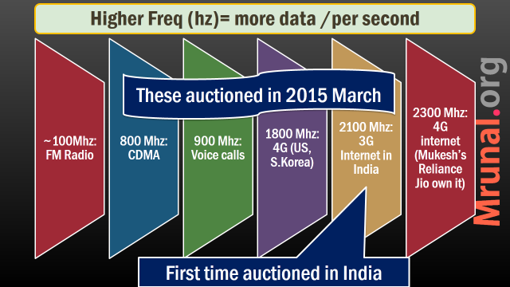
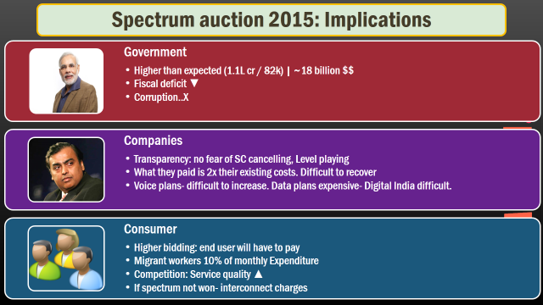
Next: Environment

